Slide 1

예약 택시
더조은컴퓨터학원
프로젝트-2차
이수영

Slide 2

index
1
please enter the title
2
please enter the title
3
please enter the title
4
please enter the title
5
please enter the title
6
please enter the title

Slide 3

01
please enter
the title

Slide 4
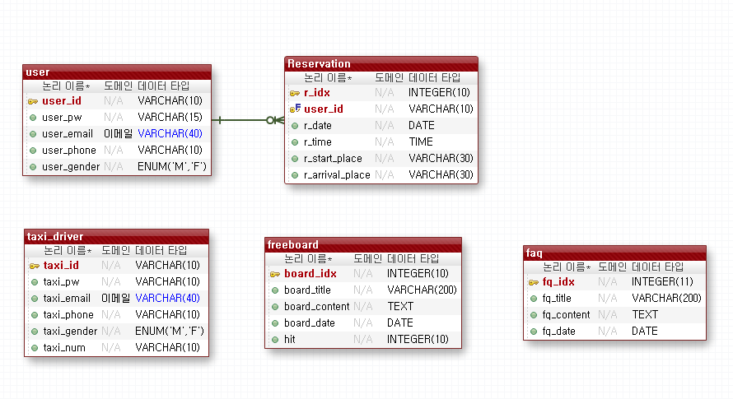
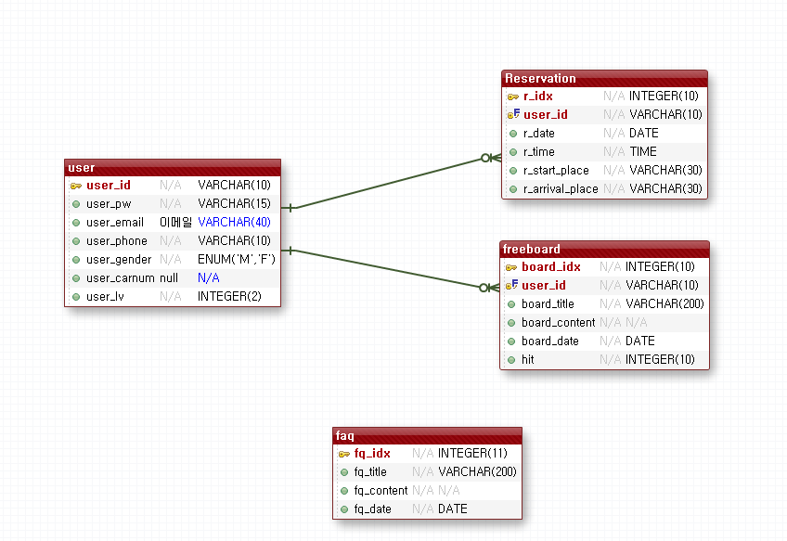
01
ERD

Slide 5
01
please enter the title
thank you for downloading yoonym's powerpoint. images and fonts are free of charge. my blog provides free powerpoint every month.
01
03
thank you for downloading yoonym's powerpoint. images and fonts are free of charge. my blog provides free powerpoint every month.
thank you for downloading yoonym's powerpoint. images and fonts are free of charge. my blog provides free powerpoint every month.
65%
satisfaction
02
04
thank you for downloading yoonym's powerpoint. images and fonts are free of charge. my blog provides free powerpoint every month.
thank you for downloading yoonym's powerpoint. images and fonts are free of charge. my blog provides free powerpoint every month.
page 01

Slide 6
01
please enter the title
thank you for downloading yoonym's powerpoint. images and fonts are free of charge. my blog provides free powerpoint every month.
65%
satisfaction
81.5%
satisfaction
72%
satisfaction
thank you for downloading yoonym's powerpoint. images and fonts are free of charge. my blog provides free powerpoint every month.
follow me and download power point for free. the copyright on powerpoint design is for yoonym. ds1104.blog.me
thank you for downloading yoonym's powerpoint. images and fonts are free of charge. my blog provides free powerpoint every month.
page 01

Slide 7


01
please enter the title
thank you for downloading yoonym's powerpoint. images and fonts are free of charge. my blog provides free powerpoint every month.
thank you for downloading yoonym's powerpoint. images and fonts are free of charge. my blog provides free powerpoint every month.
follow me and download power point for free. the copyright on powerpoint design is for yoonym. ds1104.blog.me
thank you for downloading yoonym's powerpoint. images and fonts are free of charge. my blog provides free powerpoint every month.
page 01

Slide 8

01
please enter the title
thank you for downloading yoonym's powerpoint. images and fonts are free of charge. my blog provides free powerpoint every month.
followe me
thank you for downloading yoonym's powerpoint. images and fonts are free of charge. my blog provides free powerpoint every month.
followe me
thank you for downloading yoonym's powerpoint. images and fonts are free of charge. my blog provides free powerpoint every month.
followe me
follow me and download power point for free. the copyright on powerpoint design is for yoonym. ds1104.blog.me
products line-up
followe me
follow me and download power point for free. the copyright on powerpoint design is for yoonym. ds1104.blog.me
followe me
thank you for downloading yoonym's powerpoint. images and fonts are free of charge. my blog provides free powerpoint every month.
followe me
thank you for downloading yoonym's powerpoint. images and fonts are free of charge. my blog provides free powerpoint every month.
page 01

Slide 9




01
please enter the title
thank you for downloading yoonym's powerpoint. images and fonts are free of charge. my blog provides free powerpoint every month.
01
03
thank you for downloading yoonym's powerpoint. images and fonts are free of charge. my blog provides free powerpoint every month.
thank you for downloading yoonym's powerpoint. images and fonts are free of charge. my blog provides free powerpoint every month.
02
04
thank you for downloading yoonym's powerpoint. images and fonts are free of charge. my blog provides free powerpoint every month.
thank you for downloading yoonym's powerpoint. images and fonts are free of charge. my blog provides free powerpoint every month.
page 01

Slide 10
01
please enter the title
thank you for downloading yoonym's powerpoint. images and fonts are free of charge. my blog provides free powerpoint every month.
25mm
powerpoint design is yoonym's blog
20mm
thank you for downloading yoonym's powerpoint. Images and fonts are free of charge. my blog provides free powerpoint every month.
follow me and download power point for free. the copyright on powerpoint design is for yoonym. ds1104.blog.me
15mm
10mm
5mm
1,000
2,000
3,000
4,000
page 01

Slide 11

thank you
for watching

Slide 12







